Slide 1
Data Structures & Algorithms
Abstract Data Types, Sorting Algorithms, Shortest Path Algorithms

Slide 2
What is DSA?
DSA (Data Structures and Algorithms) is a field of study in computer science that helps to optimize the organization and processing of data.
Data Structures (Data Structures): Ways of organizing and storing data so that data can be retrieved and manipulated efficiently.
Algorithms (Algorithms): A set of steps to solve a specific problem.

Slide 3
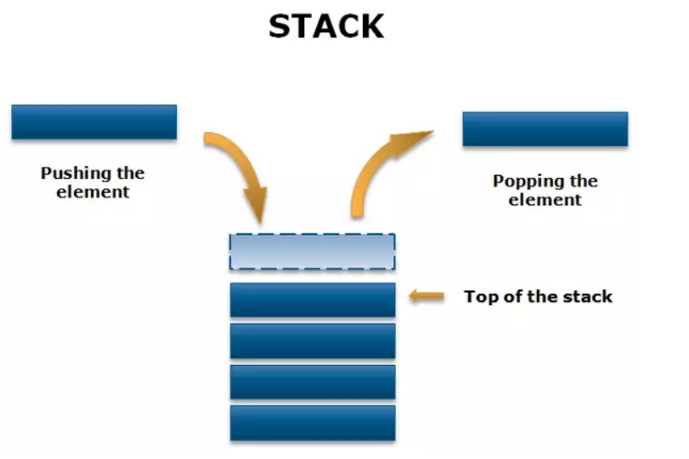
Define a Memory Stack
A stack is a data structure that operates on the "LIFO" (Last In, First Out) principle, meaning that the element added last is removed first. Stacks are commonly used for memory management in programming languages, especially for storing information about function calls and local variables.

Slide 4
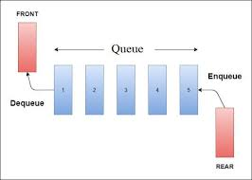
Queue
queue, understood as a queue and is a data structure that operates according to the principle: first in first out (FIFO). Intuitively, you can think of it as when you line up to buy movie tickets, whoever arrives first in line will be sold tickets first and similarly, whoever arrives later in line will be served later.

Slide 5
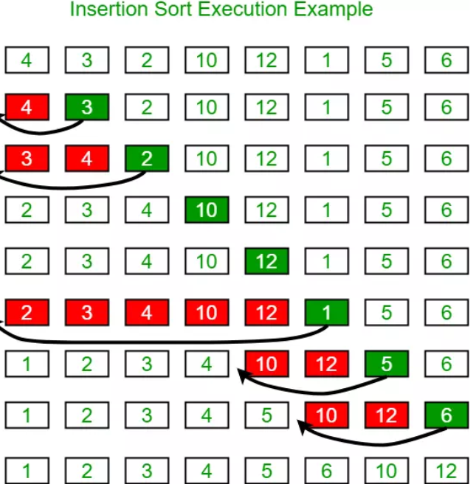
Insertion Sort
Idea: Insertion Sort is inspired by card games, where a player "inserts" a new card into a deck already arranged in his hand.
Algorithm:
At step k = 1, 2, ..., n, place the kth element in the given array in the correct position in the sequence of the first k elements.
The result is that after the kth step, the first k elements will be arranged in order.

Slide 6
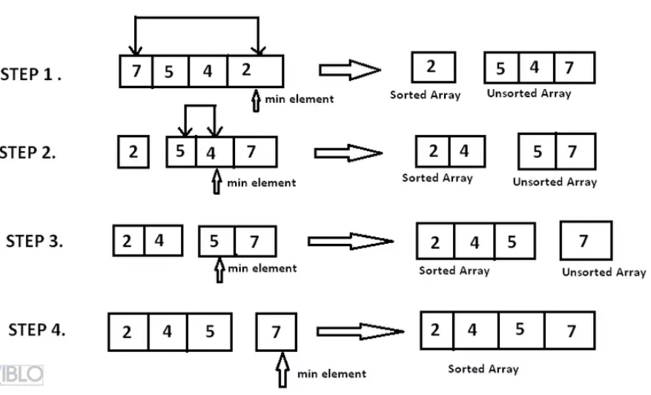
Selection Sort
The idea of ​​Selection sort is to find each element for each position of the permutation array A' that needs to be searched.
Algorithm:
Find the smallest element and put it in position 1
Find the next smallest element and put it in position 2
Find the next smallest element and put it in position 3
...

Slide 7
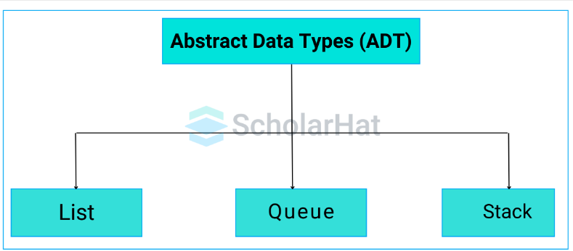
What is ADT?
An ADT (Abstract Data Type) is an abstract data type, defined by the operations it supports (add, delete, search, etc.) without regard to the detailed implementation.

Slide 8
Examples of ADTs: Stack, Queue.
import java.util.Stack;
public class StackExample {
public static void main(String[] args) {
Stack<Integer> stack = new Stack<>();
stack.push(10);
stack.push(20);
stack.push(30);
System.out.println("Top element: " + stack.peek()); // Output: 30
System.out.println("Popped element: " + stack.pop()); // Output: 30
System.out.println("Is stack empty? " + stack.isEmpty()); // Output: false
System.out.println("Remaining elements: " + stack); // Output: [10, 20]
}
}
Stack
Element 30 will be removed first because Stack is LIFO (Last In First Out).
The peek() method only looks at the element but does not remove it.
The pop() method removes and returns the element at the top.

Slide 9
Queue
Element 10 will be removed first because the Queue is FIFO (First In First Out).
The peek() method only looks at the element without removing it.
The poll() method removes and returns the element at the head of the queue.
import java.util.LinkedList;
import java.util.Queue;
public class QueueExample {
public static void main(String[] args) {
Queue<Integer> queue = new LinkedList<>();
queue.add(10);
queue.add(20);
queue.add(30);
System.out.println("Front element: " + queue.peek()); // Output: 10
System.out.println("Dequeued element: " + queue.poll()); // Output: 10
System.out.println("Is queue empty? " + queue.isEmpty()); // Output: false
System.out.println("Remaining elements: " + queue); // Output: [20, 30]
}
}

Slide 10
Stack ADT
Stack: A data structure that operates on the LIFO (Last In First Out) principle.
Main operations:
Push: Add elements to the stack.
Pop: Remove elements from the stack.
Peek: View the top element without removing.

Slide 11
For example
In a stack, elements are added according to the LIFO (Last In First Out) principle, which means that the element added last will be removed first when performing the Pop operation.
Explanation:
Suppose the initial stack contains the elements: 1, 2, 3, with 3 being the top element (top of the stack).
Initial stack:
Top -> 3
2
1
After Pop:
css
Copy code
Top -> 2
1

Slide 12
Sorting Algorithms (Bubble Sort vs QuickSort)
Bubble Sort: A simple sorting algorithm, with time complexity O(n²).
QuickSort: A faster sorting algorithm, with average time complexity O(n log n).

Slide 13
Bubble Sort
public class BubbleSort {
public static void bubbleSort(int[] arr) {
int n = arr.length;
for (int i = 0; i < n - 1; i++) {
for (int j = 0; j < n - i - 1; j++) {
if (arr[j] > arr[j + 1]) {
// Swap arr[j] and arr[j + 1]
int temp = arr[j];
arr[j] = arr[j + 1];
arr[j + 1] = temp;
}
}
}
}
Bubble Sort is a simple sorting algorithm in which elements are compared sequentially and swapped if they are out of order. This process is repeated until there are no more elements to swap.
Time complexity: O(n²)

Slide 14
QuickSort
public class QuickSort {
public static void quickSort(int[] arr, int low, int high) {
if (low < high) {
int pi = partition(arr, low, high);
quickSort(arr, low, pi - 1);
quickSort(arr, pi + 1, high);
}
}
public static int partition(int[] arr, int low, int high) {
int pivot = arr[high];
int i = low - 1;
for (int j = low; j < high; j++) {
if (arr[j] < pivot) {
i++;
// Swap arr[i] and arr[j]
int temp = arr[i];
arr[i] = arr[j];
arr[j] = temp;
}
}
// Swap arr[i + 1] and arr[high] (pivot)
int temp = arr[i + 1];
arr[i + 1] = arr[high];
arr[high] = temp;
return i + 1;
}
QuickSort is a divide-and-conquer sorting algorithm. The algorithm selects an element as the "pivot", then divides the array into two parts: elements smaller than the pivot and elements larger than the pivot. Then, the algorithm is recursively applied to the two parts of the array.
Time complexity: O(n log n) in the average case, O(n²) in the worst case.

